Slide 1
Treatment
Arterial Disease
S.Morrell NP MClSc-wound healing

Slide 2
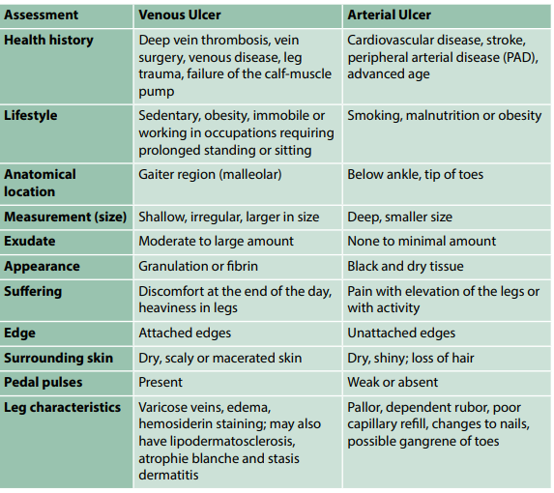

Slide 3

Treatment
Adequate perfusion indicates sufficient blood flow to support tissue viability and wound healing.
What is the treatment for arterial disease?

Slide 4
Treatment
Adequate perfusion indicates sufficient blood flow to support tissue viability and wound healing.
Treatment goal= Reducing cardiovascular risk and claudication
Lower LDL-C <2.0
Lower BP ≥ 50 yrs SBP ≤ 120; DM <130/80; other <140/90
Antiplatlet/antithrombotic
  1st line= ASA 75- 325mg Daily
  2nd line= Colpidogrel (Plavix) 75 mg daily
  Claudication- Pentoxifylline (TRENtal) 400mg TID & Statins

Slide 5
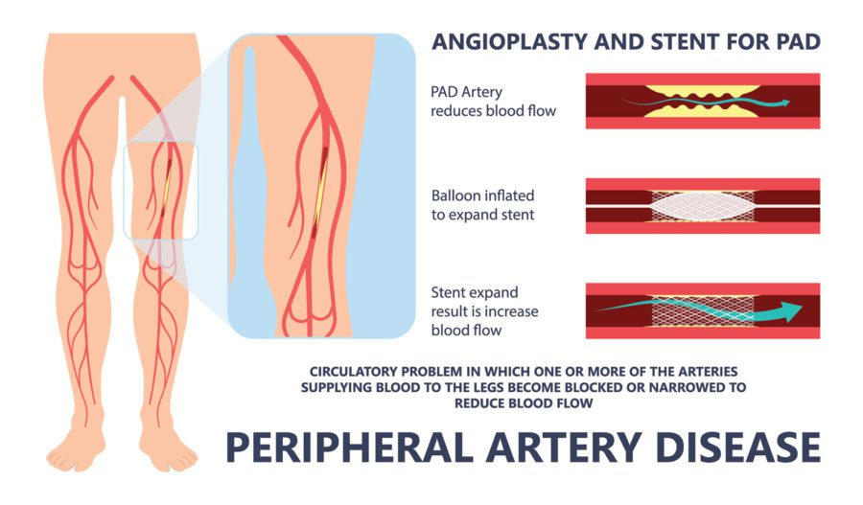
Treatment: critical limb-threatening ischemia (CLTI)
Diagnostic Imaging-
Diagnose & identify vessels (Computed tomographic angiography (CTA))
Contraindication- Normal post-exercise ABPI
Revascularization- optimal treatment CLTI
  Examples: balloon angioplasty, stent, atherectomy, thrombolysis, laser

Slide 6
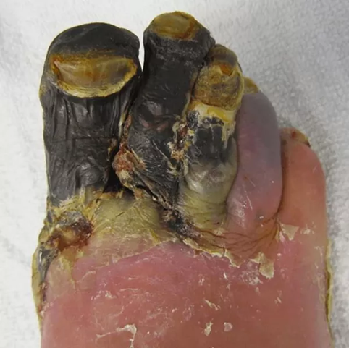
Treatment: Acute limb- ischemia (ALI)
Acute ischemia = urgent revascularization
Management ASAP- heparin and analgesics
Amputation for chronic ischemia
Failed revascularization
Lack of suitable target arteries
Severe patient comorbidities
Poor functional status
Extensive gangrene/infection & limb preservation not possible

Slide 7
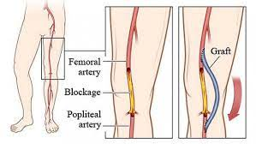
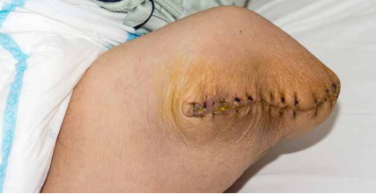
Surgical Treatment
Femoropopliteal Bypass
Below Knee Amputation

Slide 8
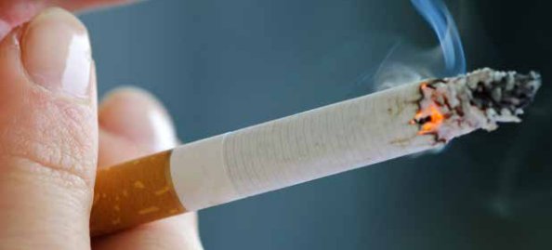
HEALTH TEACHING: ARTERIAL DISEASE
  Smoking cessation
  Control blood glucose levels
    glycated hemoglobin (A1C) levels >7.0%- increased risk of both microvascular & cardiovascular (CV) complications
  Control blood pressure
    decrease CV complications
  Assess feet
  Exercise-risk reduction
  Diet- low saturated fat

Slide 9
HEALTH TEACHING: ARTERIAL DISEASE
When do you expect they may get surgical intervention?
Pain ​
Pallor​
Pulselessness​
Paresthesia​
Paralysis​
Poikilothermia (Polar)​

Slide 10
Compression: Arterial Disease
Limited evidence- compression therapy- mixed etiology (arterial and venous)
Lower extremity edema- barrier to wound healing
Accurate blood flow determined prior to compression (consult vascular)
Lower levels of compression- ABPI >0.50 to <0.80
Avoid compression ABPI measure <0.50
After revascularization procedure- adequate blood flow
  lower compression (18–30 mmHg) after lower extremity bypass to manage edema

Slide 11
References
Orsted, H.L. & Rosenthal, S. (2021). Foundations of Best Practice for Skin and Wound Management. Wounds Canada. Ebook Available to purchase at https://www.woundscanada.ca/eboutique and the code for 25% discount on the ebook is UWNursing

